Slide 1
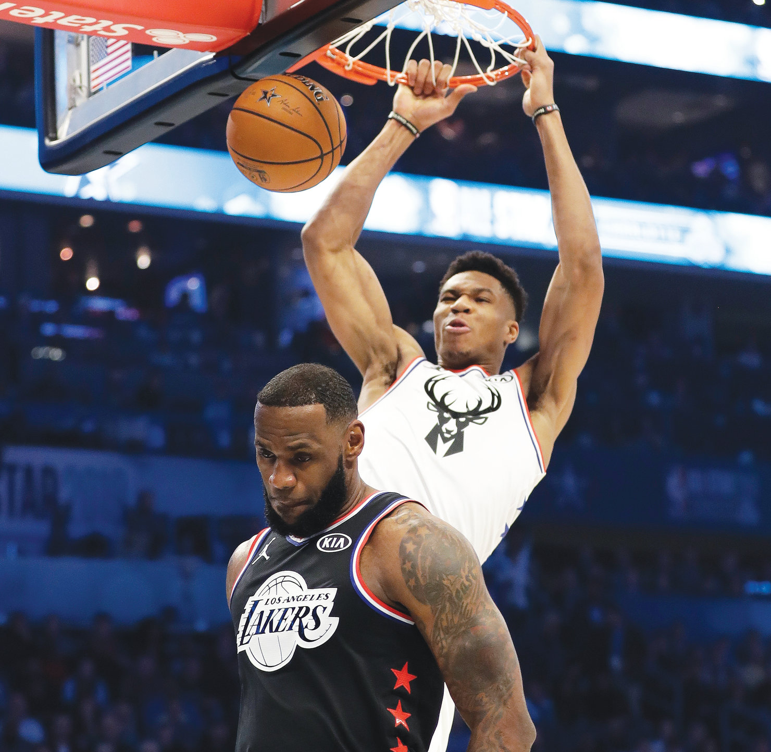
Detecting NBA Highlight Plays
Jacob Wilkens

Slide 2
Goal
Use play descriptions to train a neural network to identify highlight plays
Another way to accomplish this would have been video
Seemed to daunting of a task
Score different plays based on the descriptions
Higher score means a better play

Slide 3

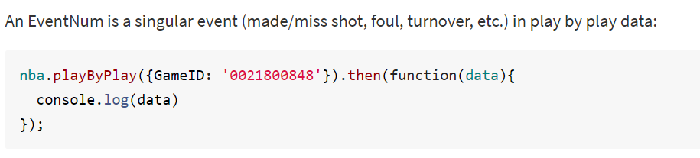
Data Gathering
There are sites which sold the desired data (www.bigdataball.com)
Cost $30 for one season and $56 - $352 for multiple seasons.
Searched for a free solution
Found a node package for nodejs to use (nba-api-client)
https://www.npmjs.com/package/nba-api-client

Slide 4

Grouping Data
Data used was saved to a CSV
Play descriptions from the 2019-20 seasons from the Bucks
About 60 seasons as that season was cancelled because of Covid
30,000 rows and only 20,000 were usable (10,000 being subs and fouls)
Test data was 20 games from Lakers from same season
5,000 actual rows
Data was put into a database

Slide 5
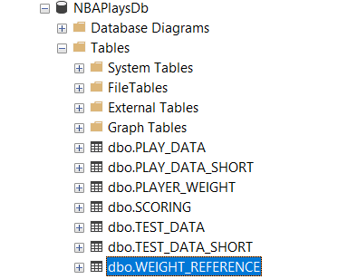
SQL Server
Constructed multiple tables for data at different stages
Rows were linked by GAME_ID and EventNum
There was a DATA table which held all information
DATA_SHORT held the short description of the play
SCORING held phrases and each phrase was individually scored
PLAYER_WEIGHT had a score for an individual player based on significance
https://nbamath.com/crystalbasketball-ranking-all-nba-players-for-2019-20/

Slide 6
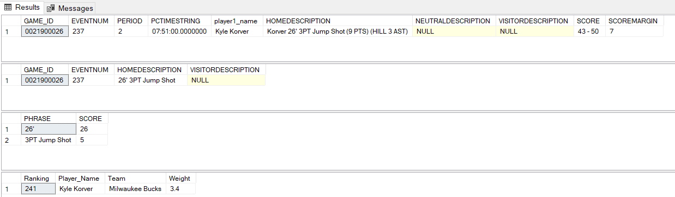
Scoring of Plays
Each record could have a home, neutral, or visitor description
Phrases were split on a ‘
A table was derived based on these phrases and each phrase had a score
The idea was to total all the phrases and player weight to find highlight plays

Slide 7
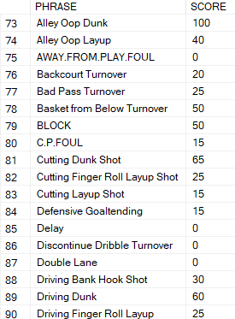
Notes about Scoring
Dunks were scored highest out of all phrases
Misses were scored to be 0
There could be more phrases as only 60 games were used in the data set
Goal was to reduce each description to generic phrases to score
Remove extra information such as the stat line and team name

Slide 8

Shortcomings
Spent too much time preparing the data and did not get to implementing the neural network
Would have used KERAS
Word descriptions leave out important details
Ankle breakers, posterizers (dunking on someone), and clutch shots
Did have access to time and score for each play
Would have implemented a time scoring multiplier

Slide 9
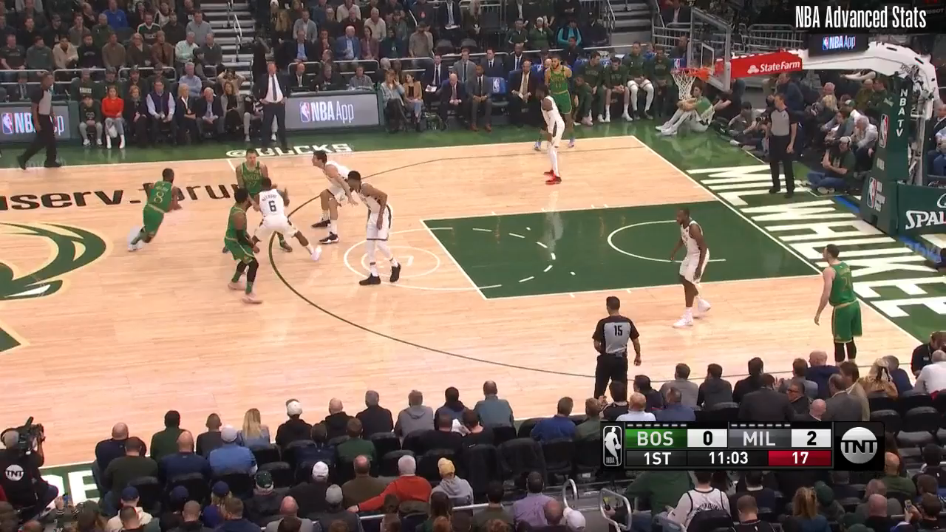
Final Thoughts
Using descriptions can be useful however certain details can be missed
There is a lot of generalizing with just descriptions
Data preparation took the entire time while working on the project
Finding data and also cleaning it to be usable
Did have access to video clips for most of the plays
This play had a high score of 85.26

